Slide 1
CROP YIELD, AREA &
PRODUCTION ANALYSIS
AND PREDICTION IN INDIA
🌾
Using Data Analytics & Machine Learning
Five Agricultural Years: 2021-22 to 2025-26 | 30 Crops | 3 Seasons
Presented by: Rubhashree M | Reg. No.: 2514021
30
5
3
Guide: Dr M Balaji
Crops
Years
Seasons

Slide 2
Table of Contents
01
Project Overview & Objectives
08
Chart 9 — Model Comparison (Detailed)
Slide 3
Slide 11
02
Data Collection & Cleaning
09
Why Random Forest was Selected
Slide 4
Slide 12
03
Chart 1 — Year-wise Trends
10
Chart 10 & 11 — Actual vs Predicted
Slide 5
Slide 13
04
Chart 2 & 3 — Top Crops Area & Production
11
Chart 12 & 13 — Residuals & Feature Importance
Slide 6
Slide 14
05
Chart 4 & 5 — Yield & State Analysis
12
Chart 14 & 15 — Forecasts
Slide 7
Slide 15
06
Chart 6, 7 & 8 — Season & Correlations
13
Conclusion, Literature & Thank You
Slide 8–9
Slide 16–18
07
Feature Engineering
Slide 10

Slide 3
Project Overview & Objectives
Section 1 — Overview
5 Years
30 Crops
3 Seasons
78 Rows
2021-22 to 2025-26
State-wise Tracked
Kharif·Rabi·Summer
19 Clean Features
Problem Statement
Key Objectives
India's agricultural sector faces challenges in planning due to unpredictable crop yields. Accurate forecasting is essential for food security, policy decisions, and resource allocation.
1
Analyse year-wise & season-wise trends in Area, Production & Yield
2
Identify top-performing crops State-Wise across all 3 metrics
Tools & Technologies
3
Build & evaluate 6 ML regression models for crop forecasting
Python:
Pandas, NumPy, Scikit-learn
Models:
Linear, Ridge, Lasso, DT, RF, XGBoost
4
Generate accurate 2025-26 production forecasts for all major crops
Visuals:
Matplotlib, Seaborn (15 charts)
Data:
Govt of India — Agricultural Statistics
5
Forecast 2026-27 production using growth rate extrapolation

Slide 4
Data Collection & Cleaning Pipeline
Section 1 — Data
Section 1: Raw CSV → 78 clean rows × 19 features
01
02
03
04
05
Load CSV
→
Rename Cols
→
Remove Aggs
→
Flag Special
→
Save Clean
104 rows × 17 cols
Govt Portal
15 metrics → short
aliases (Area_2122…)
Drop 7 summary rows
104 → 78 rows
Cotton/Jute/Mesta
→ Bale units flagged
78 × 19 cols
cleaned_crop_data.csv
📦 Raw Data Details
🧹 Cleaning Actions
•
Source: Unified Portal for Agricultural Statistics (Govt. of India)
✓
Renamed 15 metric columns to short aliases (Area_2122, etc.)
•
National-level file: 104 rows × 17 columns
✓
Removed 7 aggregate rows → 104 rows reduced to 78
•
Columns: Crop name, Season + 15 numeric metric columns
✓
Flagged bale-unit crops (is_bale_unit column added)
•
Special crops: Cotton, Jute, Mesta, Sannhemp (in Bales, not MT)
✓
Added is_2526_preliminary flag for forecast year
•
Year 2025-26 flagged as preliminary — treated with caution
✓
Final clean shape: 78 rows × 19 columns → saved as CSV ✅

Slide 5
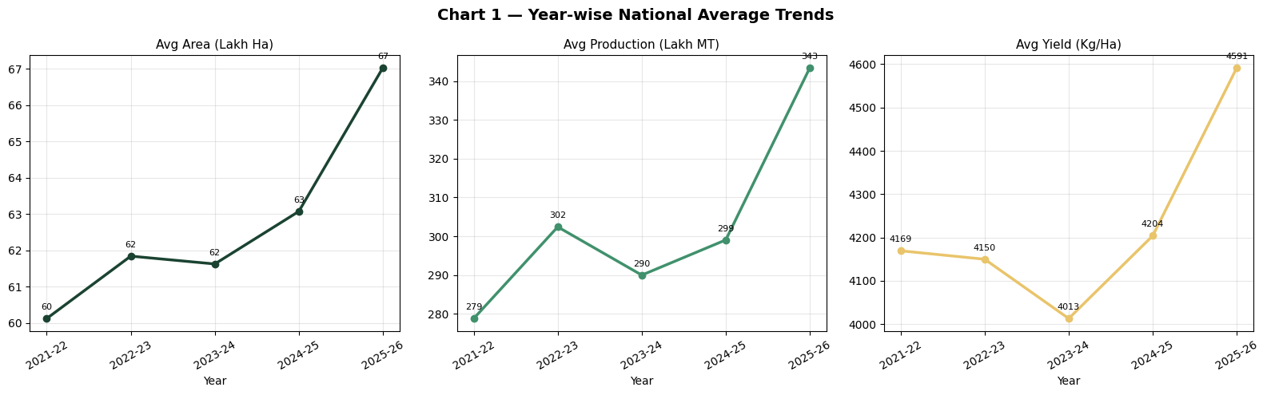
Chart 1 — Year-wise National Average Trends
Section 2 — EDA Chart 1
Consistent upward trend in Area, Production & Yield from 2021-22 to 2025-26
📈
Area: 60 → 67 Lakh Ha (+11.7%). 2023-24 dip (62) followed by sharp rise in 2025-26
📦
Production: 279 → 343 Lakh MT (+22.9%). 2023-24 dip at 290, highest in 2025-26
🌾
Yield: 4013 Kg/Ha lowest in 2023-24 (drought impact), recovered to 4591 in 2025-26
✅
2023-24 dip is consistent across all 3 metrics — likely weather or policy effect

Slide 6
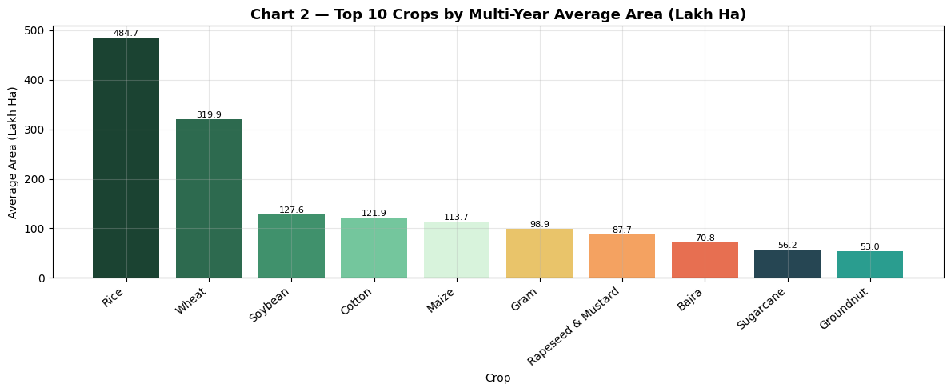
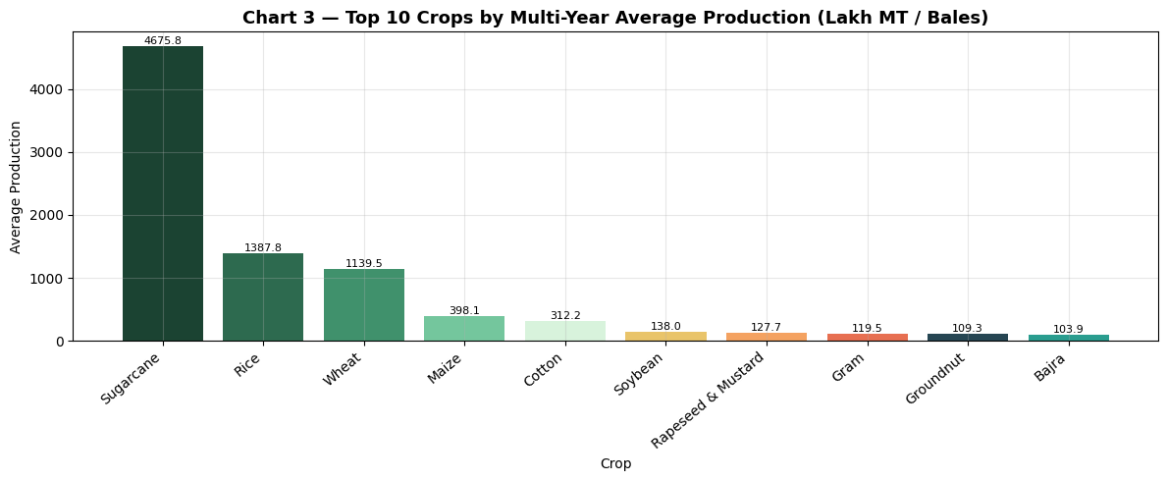
Chart 2 & 3 — Top 10 Crops by Area & Production
Section 2 — EDA Chart 2&3
Multi-year averages. Rice dominates area; Sugarcane dominates production as an outlier.
🥇
Rice (484.7 Lakh Ha) leads area — almost 1.5× Wheat (319.9)
📊
Soybean, Cotton, Maize: significant area but moderate production shows low yield
🏆
Sugarcane (4675.8 Lakh MT) is production outlier — 3.4× Rice (1387.8)
✅
Rice & Wheat: backbone of India's food security — largest area & high production
⚠️
Sugarcane dominance distorts all-crop averages — separate analysis needed

Slide 7
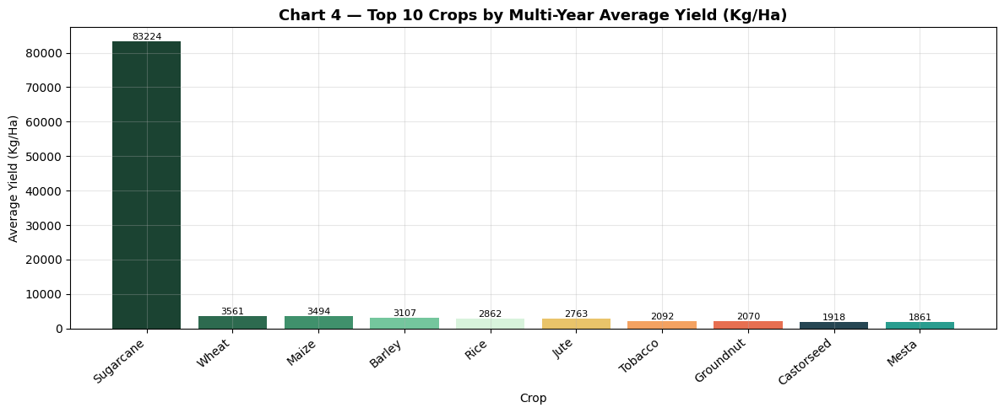
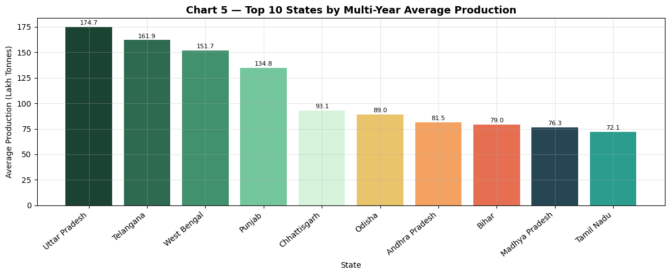
Chart 4 — Top Crops by Yield | Chart 5 — Top States by Production
Section 2 — EDA Chart 4&5
Sugarcane yield outlier at 83,224 Kg/Ha. UP leads state-wise production.
⚠️
Sugarcane yield = 83,224 Kg/Ha — 23× higher than Wheat (3,561). Pure outlier effect.
📍
Telangana (161.9), West Bengal (151.7): high productivity despite smaller area
🌾
Wheat (3,561), Maize (3,494), Barley (3,107): high-yield crops worth scaling
💡
Tamil Nadu (72.1) — relatively lower but rising production trend observed
🏅
Uttar Pradesh (174.7 Lakh T) tops state production — Sugarcane & Wheat belt

Slide 8
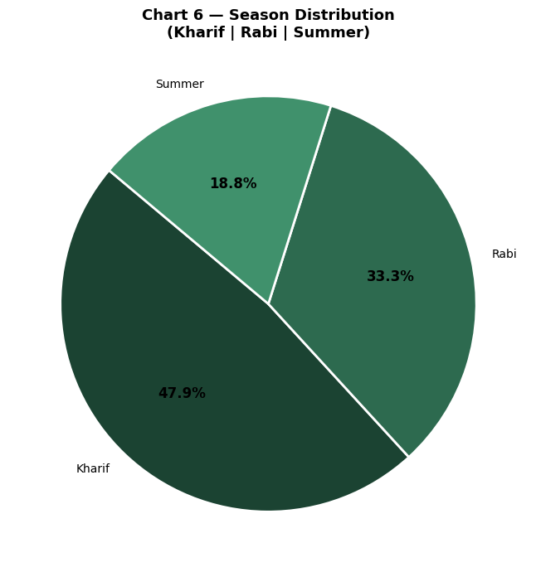
Chart 6 — Season Distribution (Kharif | Rabi | Summer)
Section 2 — EDA Chart 6
Kharif dominates with 47.9% of crop rows; Summer contributes only 18.8%
Season
Breakdown
Key Observations
• Kharif leads due to rice — India's primary food crop (monsoon-dependent)
Kharif: 47.9%
June–Nov: Monsoon season. Rice, Maize, Soybean, Cotton
• Rabi anchored by wheat — critical winter staple crop
• Summer crops smaller in count but important for regional food systems
Rabi: 33.3%
Oct–Mar: Winter season. Wheat, Gram, Rapeseed
• Season encoding (one-hot) used as feature in all ML models
Summer: 18.8%
• Models must account for season effects on yield differences
Mar–Jun: Hot season. Vegetables, Groundnut, Rice (2nd crop)
📊
📊
💡
💡
💡

Slide 9
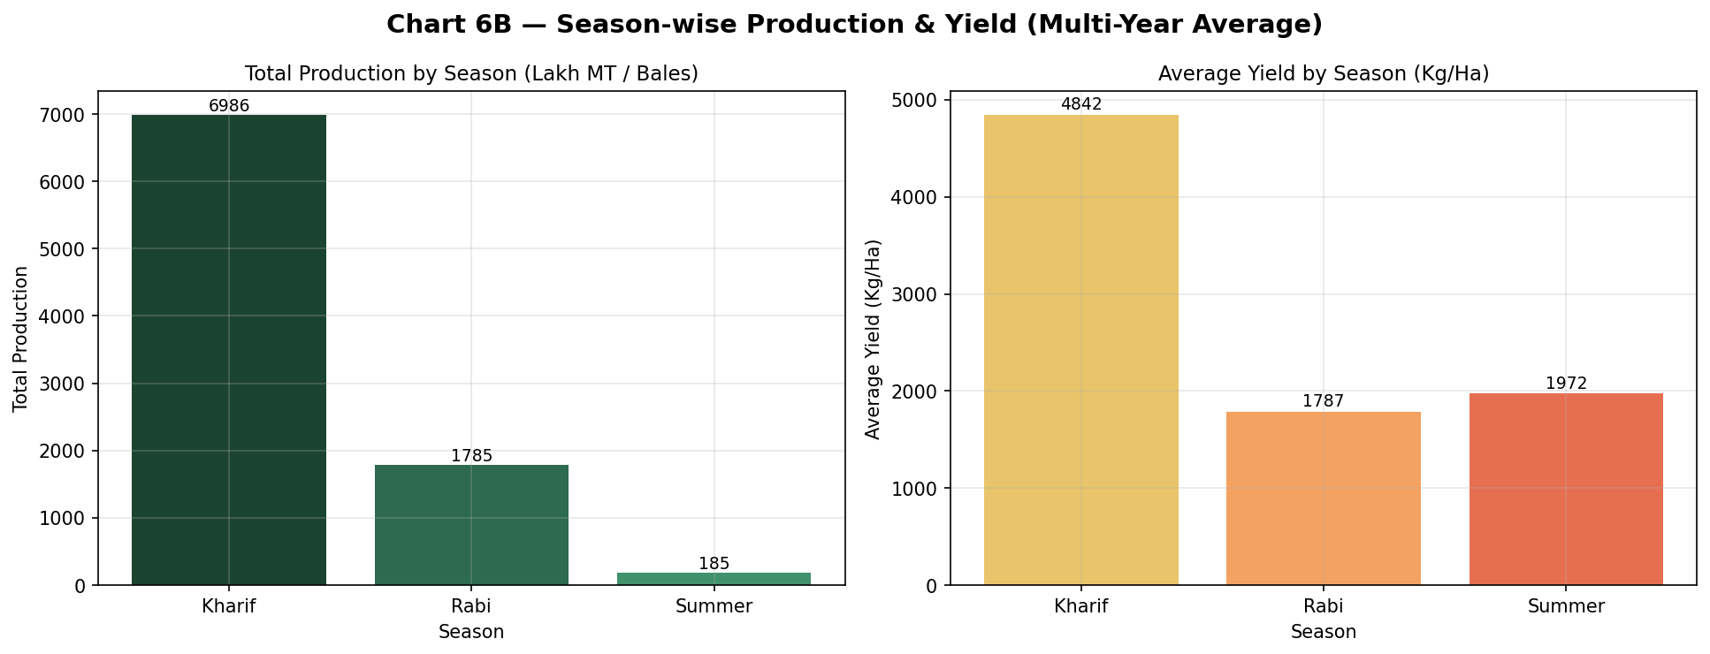
Section 2 — EDA Chart 6
Chart 6B — Season-wise Production & Yield (Multi-Year Average)
Season
Breakdown
Key Observations
• Kharif leads due to rice — India's primary food crop (monsoon-dependent)
Kharif: 47.9%
June–Nov: Monsoon season. Rice, Maize, Soybean, Cotton
• Rabi anchored by wheat — critical winter staple crop
• Summer crops smaller in count but important for regional food systems
Rabi: 33.3%
Kharif: 6,986 Lakh MT — about 78% of total production across the three seasons, also the highest average yield (4,842 Kg/Ha).
Rabi: 1,785 Lakh MT (~20% share), with average yield of 1,787 Kg/Ha — moderate volume, moderate productivity.
Summer: smallest volume (185 Lakh MT, ~2% share), but yield (1,972 Kg/Ha) is close to Rabi's despite far less area under cultivation.
Compared to Chart 6's row-count split (Kharif 47.9% / Rabi 33.3% / Summer 18.8%), Kharif's production share (78%) is much higher than its crop-count share — meaning Kharif crops are, on average, heavier producers per entry.
Summer: 18.8%

Slide 10
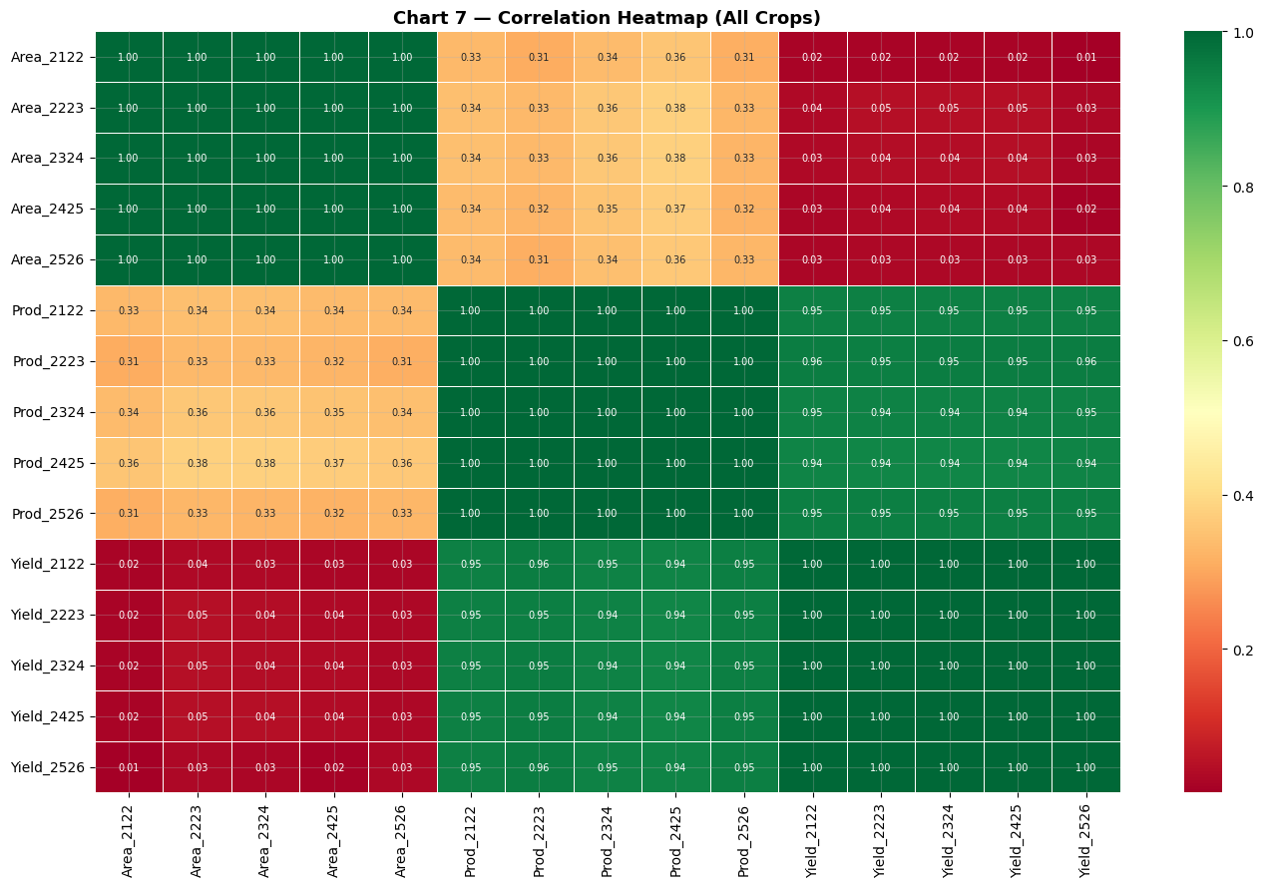
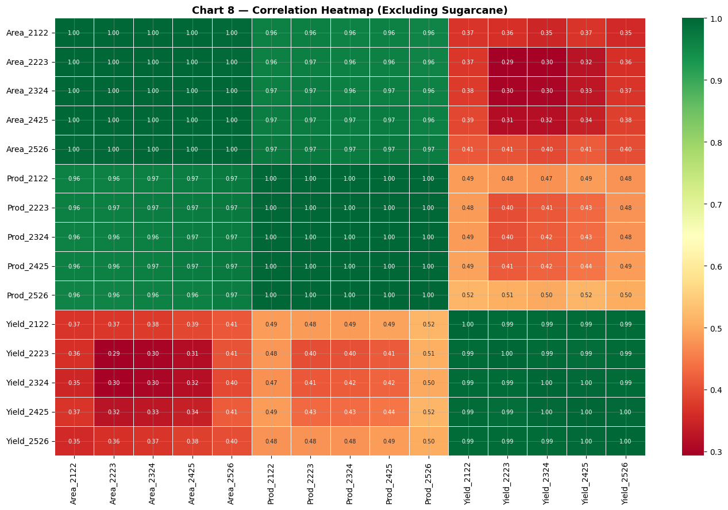
Chart 7 & 8 — Correlation Heatmaps
Section 2 — EDA Chart 7&8
With all crops vs. excluding Sugarcane outlier — reveals true Area-Production relationship
Chart 7 — All Crops (Sugarcane included)
Chart 8 — Excluding Sugarcane Outlier
🔗
🔗
⚠️
✅
Area–Area & Prod–Prod correlations: r ≈ 1.00 across years — stable growth patterns
⚠️
With Sugarcane: Area–Prod r ≈ 0.31–0.36 only (Sugarcane's extreme yield masks pattern)
✅
Without Sugarcane: Area–Prod r jumps to ≈ 0.96–0.97 — strong predictability restored

Slide 11
Feature Engineering — Section 3
Section 3 — Feature Eng
Wide → Long reshape + 13 engineered predictors used in all ML models
WIDE FORMAT
LONG FORMAT
# Lag & Interaction features
78 rows × 19 cols
(one row per crop-season)
390 rows × 25 cols
(one row per crop-season-year)
df["Prod_lag1"] = df.groupby(["Crop","Season_enc"])["Production"].shift(1)
→
df["Yield_lag1"] = df.groupby(["Crop","Season_enc"])["Yield"].shift(1)
df["Area_x_Yield"] = df["Area"] * df["Yield"]
df["Prod_trend"] = df.groupby(["Crop","Season_enc"])["Production"].pct_change()
13 Engineered Features (FEATURES list passed to all models)
01
Yield
22.6%* Second top feat
06
Area
1.6%
11
Prod_trend
Trend signal
Production ÷ Area
Current cultivated area
YoY % change production
02
Prod_lag1
37.9%* first top feat
07
Year_num
Trend feature
12
Area_trend
Trend signal
Prior year production
Numeric year (2021–2025)
YoY % change in area
03
Yield_lag1
19.8%–21.5%
08
Crop_enc
Identity feature
13
is_bale_unit
Unit correction
Historical yield
Label-encoded crop name
Bale-unit crop flag
04
Area_x_Yield
14.4%–17.3%
09
Season_enc
Categorical
Area × Yield interaction
Label-encoded season
05
Area_lag1
2.2%–3.8%
10
Season dummies
One-hot encoded
Prior year cultivated area
One-hot: Kharif/Rabi/Summer

Slide 12
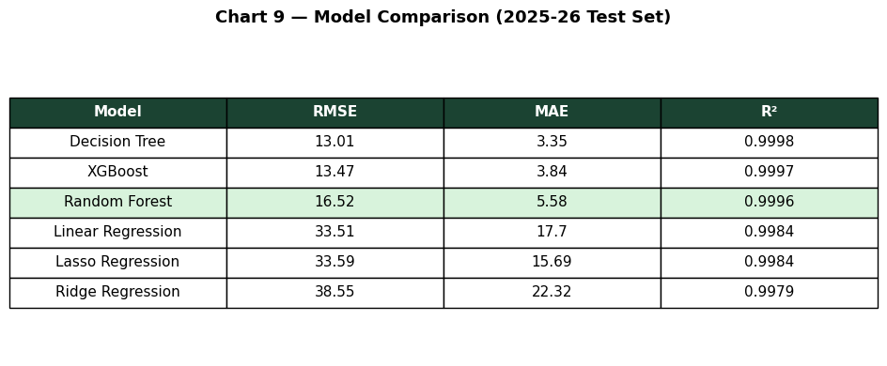
Chart 9 — Model Comparison (2025-26 Test Set)
Section 4 — Model Evaluation
Detailed evaluation of all 6 ML models | Time-based split: Train 2021-24, Test 2025-26
How Models Were Compared
📐
RMSE — Root Mean Squared Error: penalises large errors heavily. Lower = better.
📏
MAE — Mean Absolute Error: average prediction error in production units. Lower = better.
📈
R² Score — coefficient of determination: 1.0 = perfect model. Closer to 1 = better.
All 6 Models — What Each Does
Time-split: all models trained on 2021-24, tested on 2025-26 to prevent data leakage.
Linear Regression
RMSE:33.51 MAE:17.7 R²:0.9984
Assumes all features have linear additive effect. Simple but misses non-linear crop interactions.
Ridge Regression
RMSE:38.55 MAE:22.32 R²:0.9979
Linear + L2 penalty. Shrinks coefficients to reduce overfitting. Slight improvement in variance control.
Lasso Regression
RMSE:33.59 MAE:15.69 R²:0.9984
Linear + L1 penalty. Drives some coefficients to zero (feature selection). Similar to Ridge here.
Decision Tree
RMSE:13.01 MAE:3.35 R²:0.9998
Tree-based: splits data by feature thresholds. Handles non-linearity but prone to overfit.
Random Forest ✓
RMSE:16.52 MAE:5.58 R²:0.9996
Ensemble of 200 trees. Averages predictions → reduces overfitting. SELECTED MODEL.
XGBoost
RMSE:13.47 MAE:3.84 R²:0.9997
Gradient boosting on trees. Highly accurate but Decision Tree overfits here at depth=8.

Slide 13
Why Random Forest Was Selected as the Final Model
Section 4 — Model Selection
A detailed analysis of the selection rationale over Decision Tree & XGBoost
🏆 Random Forest Regressor — RMSE: 16.52 | MAE: 5.58 | R²: 0.9996 | Stability: Highest
n_estimators=200 | max_depth=8 | random_state=42 | n_jobs=-1 (trained on 2021-24, tested on 2025-26)
🌲
01 Ensemble = Stability
⚖️
03 Balanced Accuracy vs Robustness
🔁
05 Handles Missing Data Gracefully
Random Forest trains 200 individual decision trees on random subsets of data (bagging). Final prediction is the average of all 200 trees. This averaging effect drastically reduces variance and overfitting — something a single Decision Tree cannot do.
XGBoost scored slightly better on test (RMSE 13.47, R²=0.9997) but is more sensitive to hyperparameters and can overfit with sequential tree boosting. RF is more robust and production-safe for annual re-training.
With only 78 clean rows, some crop-season-year combinations have null lags. RF trees can route samples down alternative branches when a feature is NaN, without breaking the entire prediction pipeline.
💡 Decision Tree (RMSE 13.01) likely memorised training data at depth=8; RF averages away this noise.
💡 For recurring annual forecasts, a stable model is preferred over marginal RMSE gains.
💡 This robustness is critical when preliminary 2025-26 data is used for forecasting.
🔀
02 Handles Non-linearity
📊
04 Feature Importance Built-in
💾
06 Serialisable & Deployable
Crop production relationships are complex and non-linear. Area×Yield interaction, lag features, and seasonal effects cannot be captured by Linear/Ridge/Lasso models. RF tree splits naturally handle all these without explicit transformations.
RF provides native Gini-based feature importance. This confirmed Prod_lag1 (36.5%), Yield (22.6%), Yield_lag1 (19.8%) as top predictors.
RF can be saved as a .pkl file and reloaded annually with new data — no retraining of parameters, just re-fit with the updated dataset. Streamlit and Power BI dashboards can call the saved model in real-time.
💡 Linear models (RMSE 33–38) proved insufficient — RF's R²=0.9996 confirms it captures the true pattern.
💡 No additional tools needed to explain which features drive predictions.
💡 Practical deployment requirement: model must be updatable every year without code changes.

Slide 14
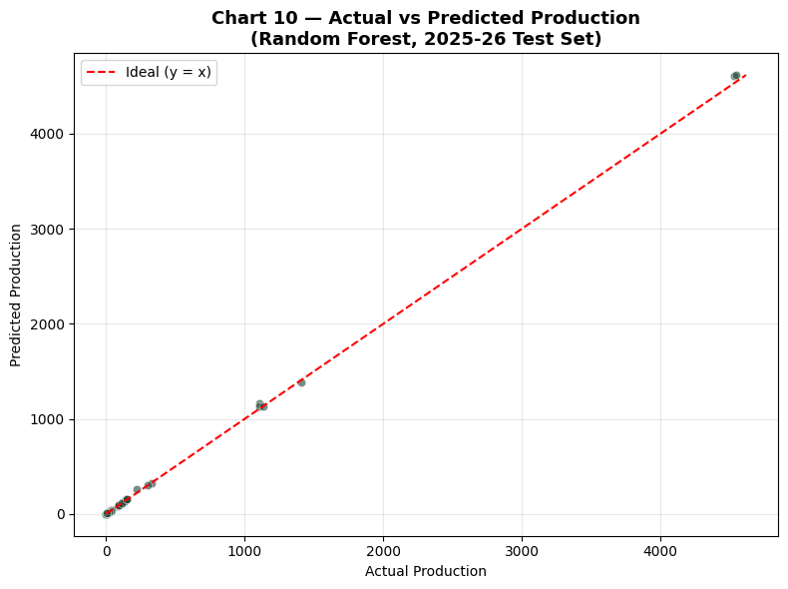
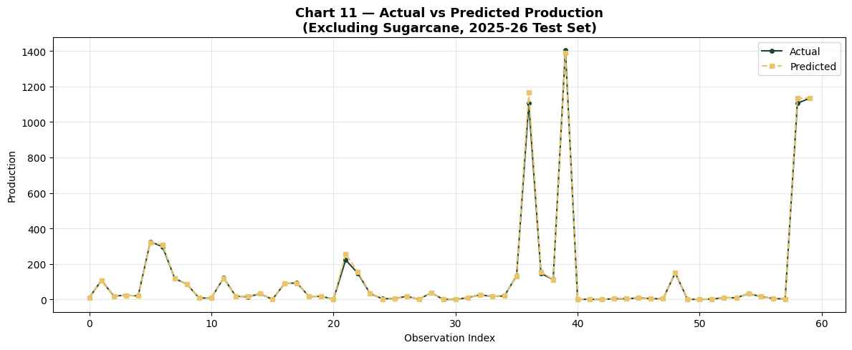
Chart 10 & 11 — Actual vs Predicted Production
Section 5 — Chart 10&11
Scatter (all crops) and Line chart (excluding Sugarcane) — Section 5: Best Model Analysis
Chart 10 — Scatter: All Crops (incl. Sugarcane)
Chart 11 — Line: Excl. Sugarcane (finer detail)
✅
Chart 10: All points lie extremely close to the y=x ideal line — model accuracy is near-perfect
🌿
Sugarcane (top-right, ~4500) is also predicted accurately despite being a major outlier
📉
Chart 11: Excluding Sugarcane shows predicted (gold dashed) trace nearly overlaps actual (green)
🏆
Near-zero residuals for most crops. Only a few mid-range observations show minor deviation

Slide 15
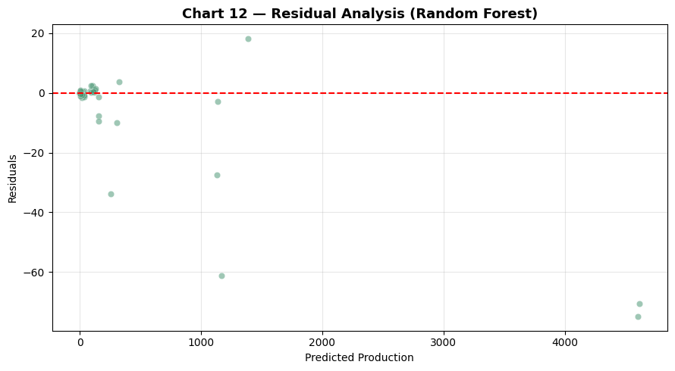
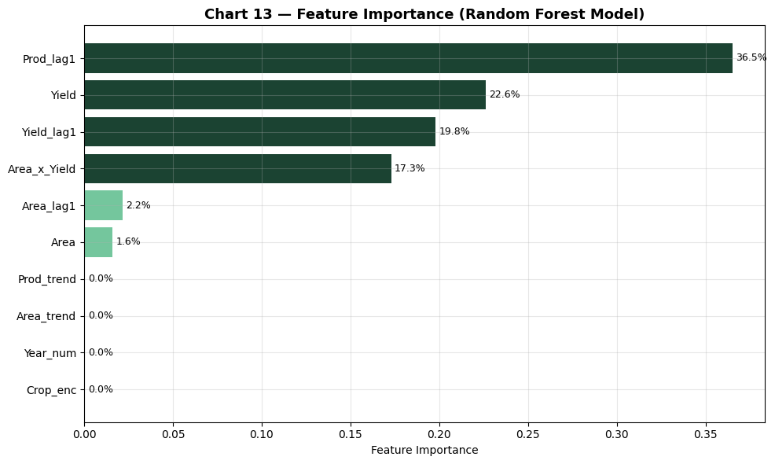
Chart 12 & 13 — Residual Analysis & Feature Importance
Section 5 — Chart 12&13
Section 5: Residuals confirm no systematic bias | Feature importance from Random Forest
Chart 12 — Residual Analysis (Random Forest)
Chart 13 — Feature Importance (Random Forest)
✅
Chart 12: Residuals mostly clustered near zero — no systematic over/under-prediction pattern
⚠️
Larger residuals appear for Sugarcane (predicted ~4500) — scale effect, not model bias
🥇
Chart 13: Prod_lag1 (36.5%) is #1 feature — prior year production is the best predictor
📊
Yield (22.6%), Yield_lag1 (19.8%), Area_x_Yield (17.3%) — top 4 explain ~96% of importance
💡
Area alone (1.6%) is weak predictor; interaction Area×Yield (17.3%) is far more powerful

Slide 16
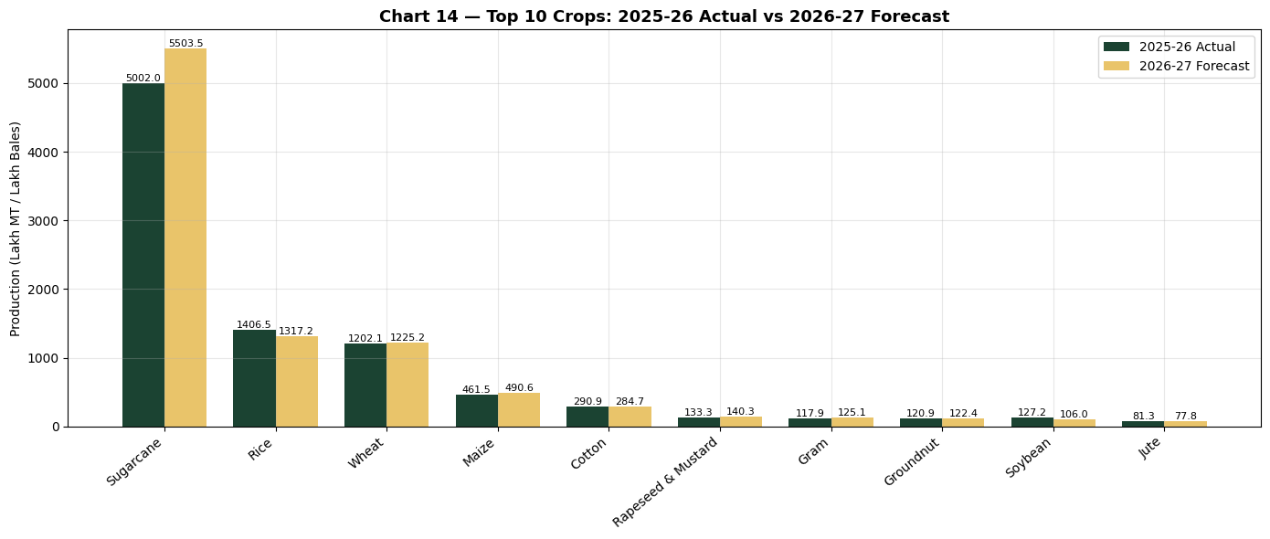
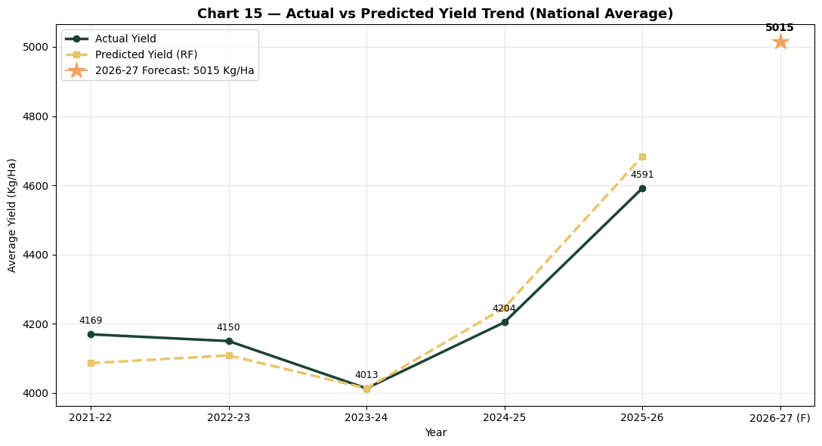
Chart 14 & 15 — Production & Yield Forecasts
Section 6 — Chart 14&15
Section 6: 2025-26 Actual vs 2026-27 Forecast | Yield trend with RF predictions
Chart 14 — Top 10 Crops: 2025-26 Actual vs 2026-27 Forecast
Chart 15 — Actual vs Predicted Yield Trend (National Average)

Slide 17
Forecast Highlights — 2025-26 & 2026-27
Section 6 — Forecasting
Section 6: Key figures from RF model predictions vs actuals
Crop | 2025-26 Actual | 2026-27 Forecast | Growth %
Sugarcane | 5,002.0 | 5,503.5 | +10.0%
Rice | 1,406.5 | 1,317.2 | -6.3%
Wheat | 1,202.1 | 1,225.2 | +1.9%
Maize | 461.5 | 490.6 | +6.3%
Cotton | 290.9 | 284.7 | -2.1%
Rapeseed & Mustard | 133.3 | 140.3 | +5.2%
Gram | 117.9 | 125.1 | +6.1%
Groundnut | 120.9 | 122.4 | +1.2%
Soybean | 127.2 | 106.0 | -16.7%
Jute | 81.3 | 77.8 | -4.3%
Forecast Insights
🌾
Sugarcane forecast +10.0% — highest absolute growth. Expansion driven by UP & Maharashtra area increase.
📈
Maize (+6.3%) & Gram (+6.1%): positive outlook driven by rising domestic demand and MSP incentives.
⚠️
Soybean (-16.7%): sharp decline forecast. Likely competition from imports and area shift to cotton.
🌱
Wheat (+1.9%): modest growth — stable. India's primary food crop remains consistently cultivated.
🔮
Avg Yield forecast: 5,015 Kg/Ha in 2026-27 — up from 4,591 in 2025-26 (+9.2% growth).

Slide 18
Conclusion, Limitations & Future Work
✅ Key Conclusions
⚠️ Limitations
✓
Increasing trend in India's crop area (+11.7%), production (+22.9%) & yield (+10.1%) over 2021-26
⚠
Excludes weather, rainfall, irrigation & soil quality data
✓
Sugarcane is a persistent outlier — separate analysis essential to prevent model distortion
⚠
State-level area & yield data not fully integrated
✓
Random Forest selected: R²=0.9996, RMSE=16.52 — explains 99.96% of variance in crop production
⚠
2025-26 forecasts rely on preliminary area data
✓
Top predictors: Prod_lag1 (36.5%), Yield (22.6%), Yield_lag1 (19.8%), Area×Yield (17.3%)
⚠
Linear growth assumption may miss climate-driven shocks
✓
2026-27 forecast: Avg yield 5,015 Kg/Ha — strong positive trajectory
⚠
Only 5 years of data — limited temporal depth for deep learning
Future Work
🛰️
🧠
🗺️
📊
🌍
Satellite & Climate Data
LSTM / Transformer
District-Level
Live Dashboard
Cross-Country
Integrate satellite imagery & rainfall for precision forecasting
Deep learning models for temporal sequence modelling
Extend to district-level for targeted interventions
Streamlit / Power BI for policymakers
Comparative ML crop studies globally

Slide 19
Literature Survey & Project Alignment
1
Random Forest & XGBoost consistently outperform linear models in crop yield prediction tasks
✓ RF selected as best model
Source: Peer-reviewed agricultural ML literature (2019–2024)
2
Lag features & interaction terms are critical for time-series agricultural data
✓ Prod_lag1, Area×Yield added
Source: Feature engineering for temporal agricultural forecasting
Ensemble methods preferred over single models for agricultural production forecasting
✓ SHAP confirms Chart 13 ranks
3
✓ RF (200 trees) vs DT
Source: Ensemble learning in precision agriculture (2023)
4
Time-based splitting essential — random splits cause data leakage in time-series
✓ Train 2021-24, Test 2025-26
Source: ML methodology best practices for forecasting
5
Outlier crops (Sugarcane) must be handled separately to avoid distorting model fit
✓ Separate heatmaps done
Source: Indian crop yield prediction studies (ICAR, 2021)

Slide 20
Thank You
🌾
Crop Yield, Area & Production Analysis and Prediction in India
Rubhashree M | Reg. No.: 2514021
Guide: Dr M Balaji
🤖
📊
🌾
🔮
0.9996
Best Model
R² Score
Crops
Forecast
R² Score (RF)
Random Forest
0.9996
30 Crops
2026-27
16.52
RMSE — Test Set
5,015
Forecast Yield 2026-27
Questions & Discussion
30
Crops Forecasted

